Slide 1
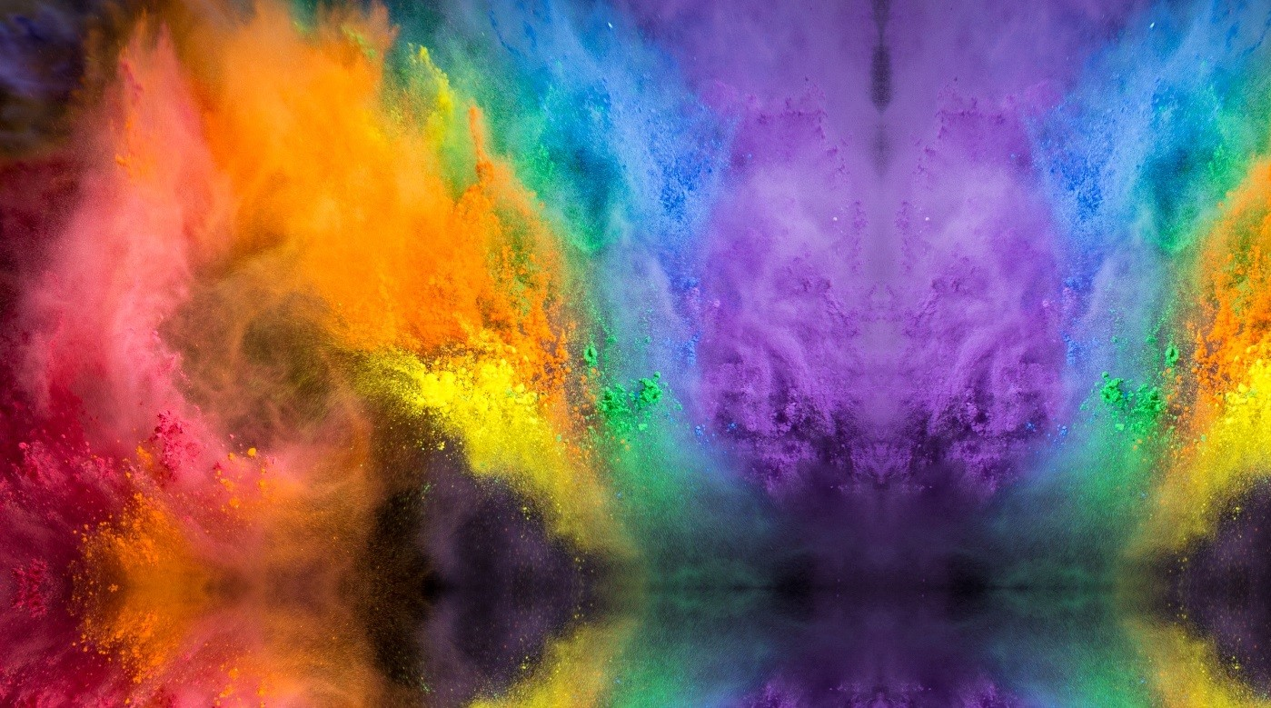
Powder Info. &
Clean-Up Tips!!
The color powder being used today is 100% non-toxic & biodegradable. It is corn-starch-based, food and cosmetic grade.
CLEAN UP:
Skin: Dust off as much dry powder as you can before you apply any water. Shower or bathe as usual.
Hair: Dust any loose powder out of your hair prior to wetting. Wash your hair as you normally would. It is not uncommon for hints of the color, purple particularly, to stick around for a few washes.
Clothes: Remove all excess powder before adding water. Wash your clothes separately, with COLD water and detergent.
NOTE: Although this powder has been deemed safe and washable by the manufacturer, it may affect fabrics or materials differently and there is no guarantee it will not stain.
For more information on the powder, visit: colorblaze5k.com
The Navy does not endorse any company, product or service.

